Slide 1

ROHAN NIRANJAN KALPAVRUKSHA
Pace University
Advanced Pattern Recognition And Machine Learning
KERNEL DENSITY
BASED CLUSTERING

Slide 2
Suppose eps = 1
and MinPoints = 4
MOTIVATION
Existing Density Based Clustering
Y
DBSCAN
Categorizes data points as Core, Border, Noise
Then forms clusters
X

Slide 3
LIMITATIONS OF DBSCAN
Focus on Sample Count Over Data Density
Gives more importance to number of samples within the radius than how densely the data points are populated.
Suppose eps = 1
and MinPoints = 6

Slide 4
LIMITATIONS OF DBSCAN
2. Equal Weight to Dense and Sparse Regions
Treats regions with the same number of points within the radius equally, regardless of whether those points are densely or sparsely packed.
Suppose eps = 1
and MinPoints = 5

Slide 5
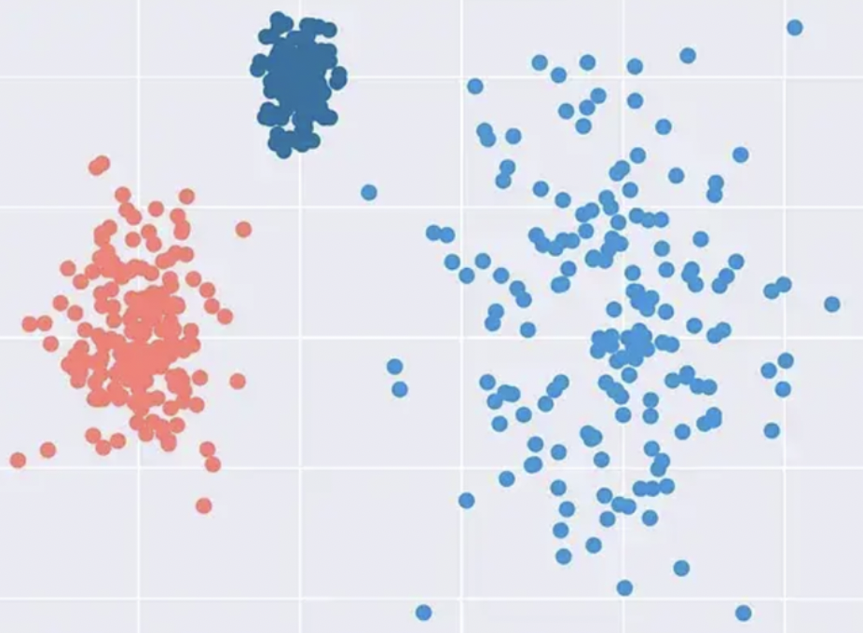
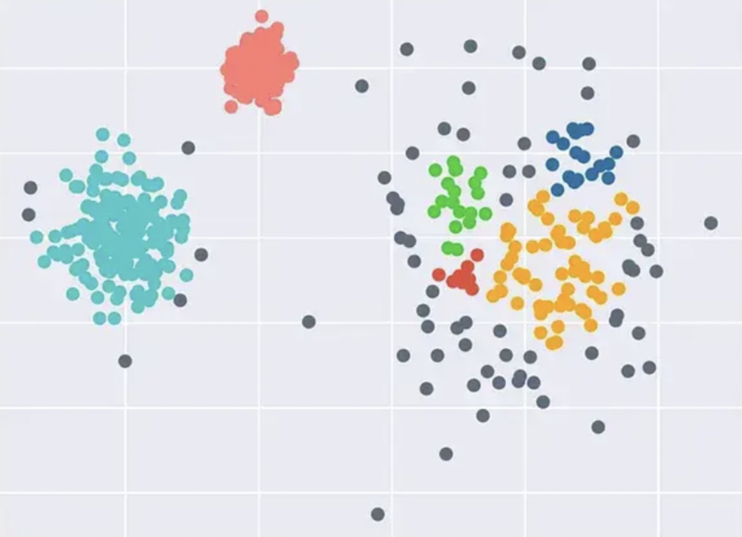
LIMITATIONS OF DBSCAN
3. Struggles with Varying Densities
DBSCAN relies on fixed minPts and epsilon parameters, which makes it challenging to handle clusters with varying densities.

Slide 6
SOLUTION
KERNEL DENSITY !!

Slide 7
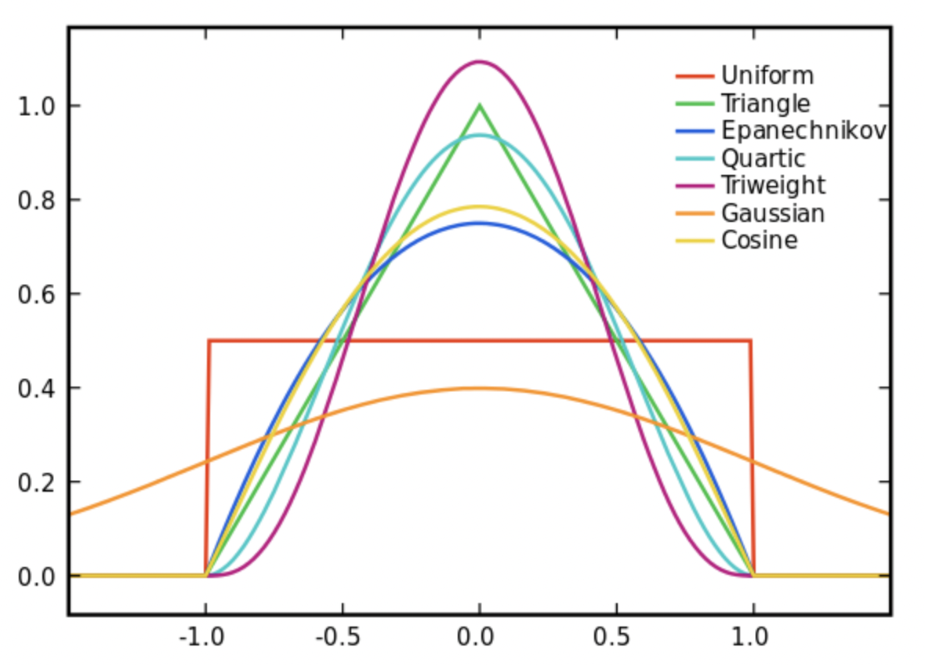
KERNEL DENSITY
KDE is a non-parametric method for estimating the Probability Density Function (PDF) of a continuous random variable.
Understand the distribution of data, Identifies outliers
KDE uses different kernel functions to smooth the data.
Rectangular: Uniform rectangular shape
Triangular: Triangular-shaped curve
Epanechnikov: Parabolic shape
Diamond: Rhombus shape
Cosine: Oscillating smooth curve
Gaussian: Bell-shaped curve

Slide 8
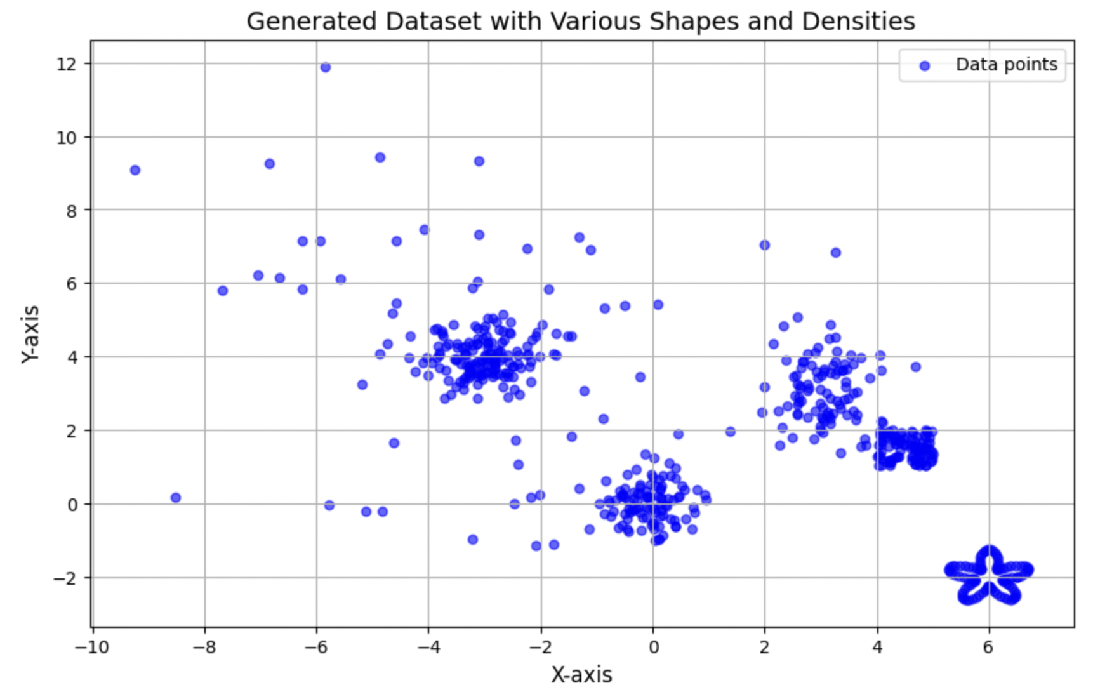
METHODOLOGY
ORIGINAL
DATA POINTS

Slide 9
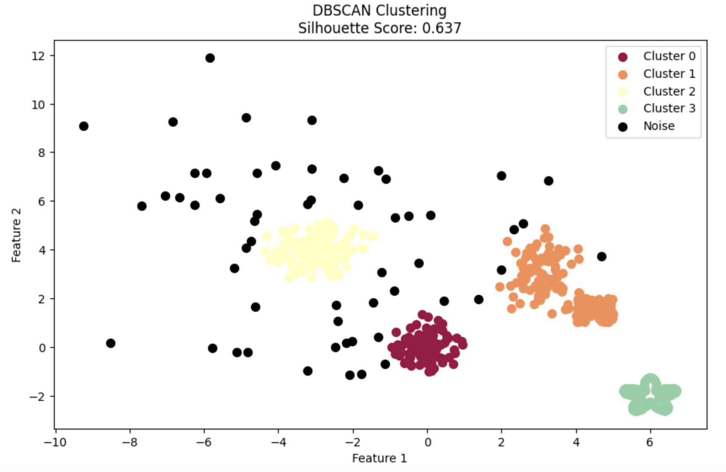
METHODOLOGY
DBSCAN
eps=0.5, min_samples=5
Silhouette Score: 0.637

Slide 10
METHODOLOGY
KERNEL DENSITY BASED CLUSTERING
Form groups within the kernel range
Compute KDE density
Identify high-density points
Cluster high-density points

Slide 11
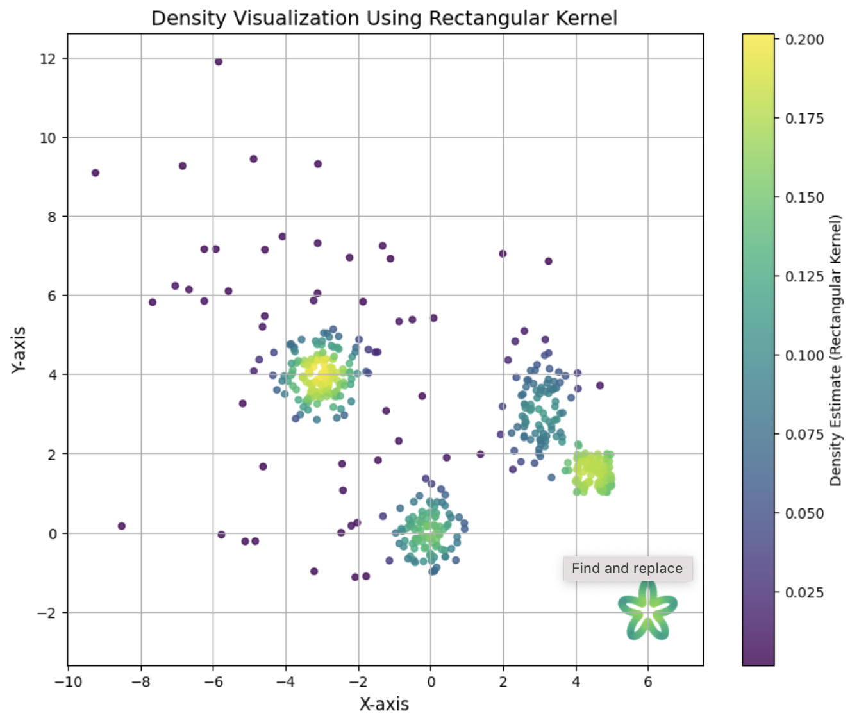
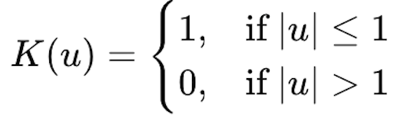
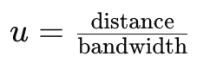
METHODOLOGY
Compute
Kernel Density

Slide 12
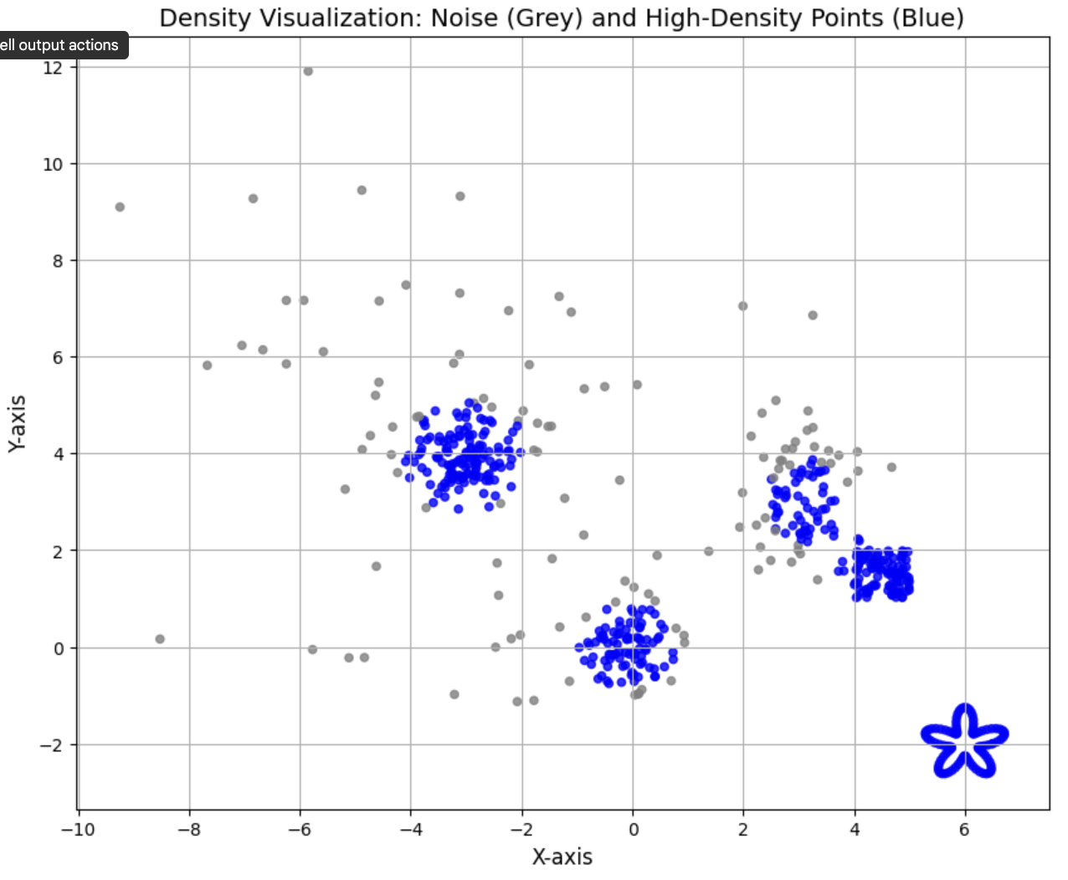
METHODOLOGY
Identify High Density Points
Set a Threshold
(top 80 perc) - High Density
Rest is considered
as noise

Slide 13
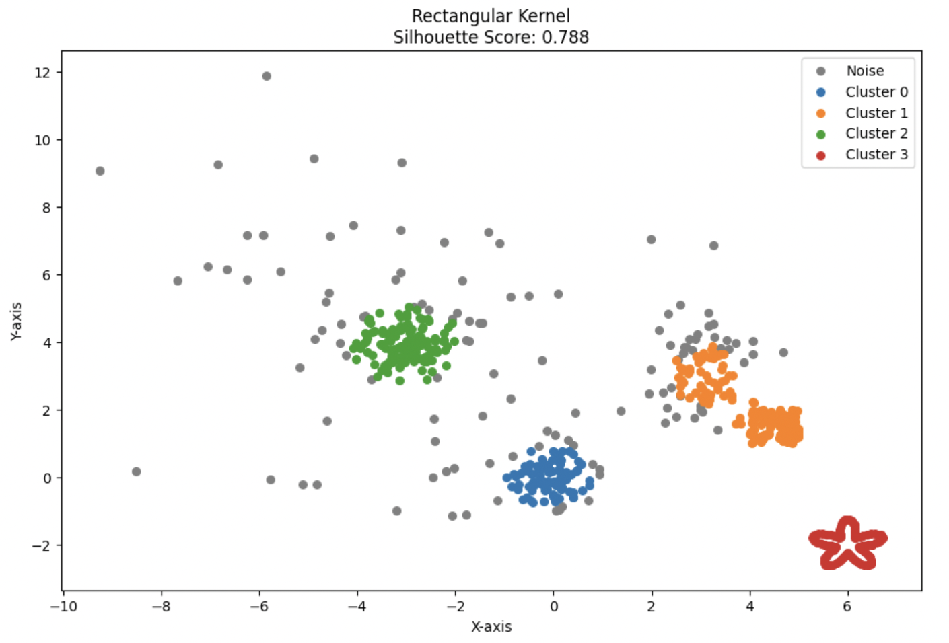
METHODOLOGY
Cluster points in kernel range
Label points into one cluster if they are within the kernel range
Silhouette Score: 0.788

Slide 14
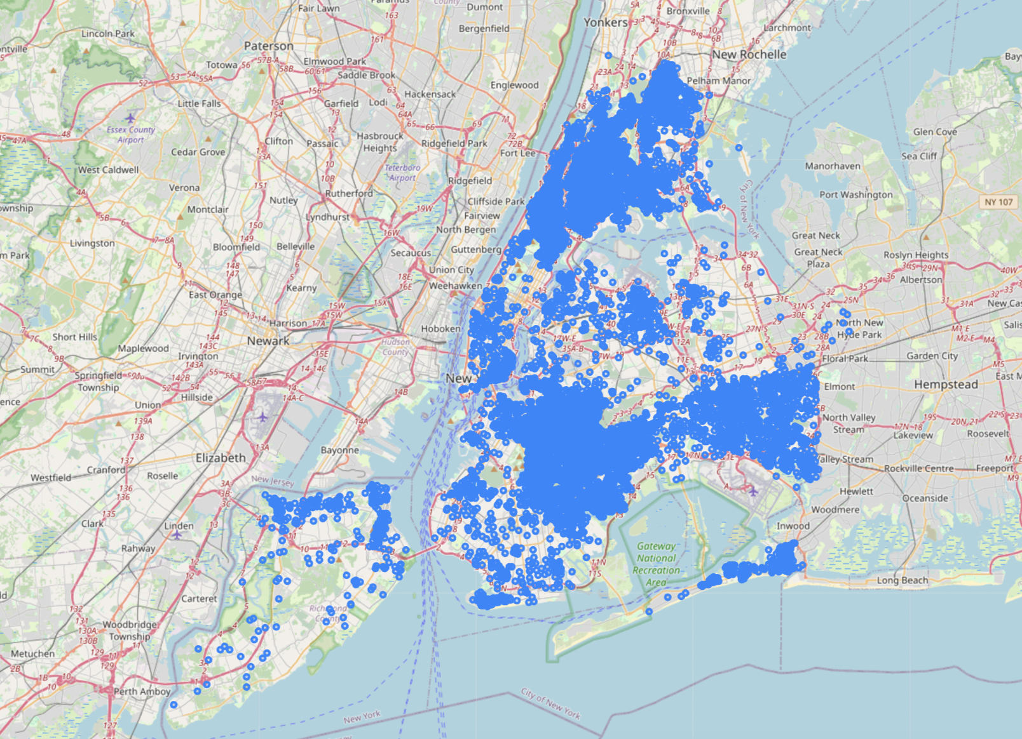
PRACTICAL EXAMPLE
DATASET
NYPD Shooting Incident Data
2006-2021

Slide 15
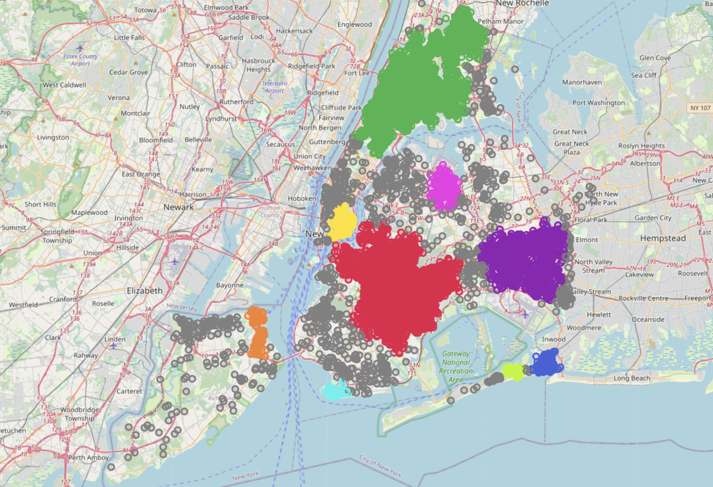
PRACTICAL EXAMPLE
DBSCAN
Silhouette Score: 0.428

Slide 16
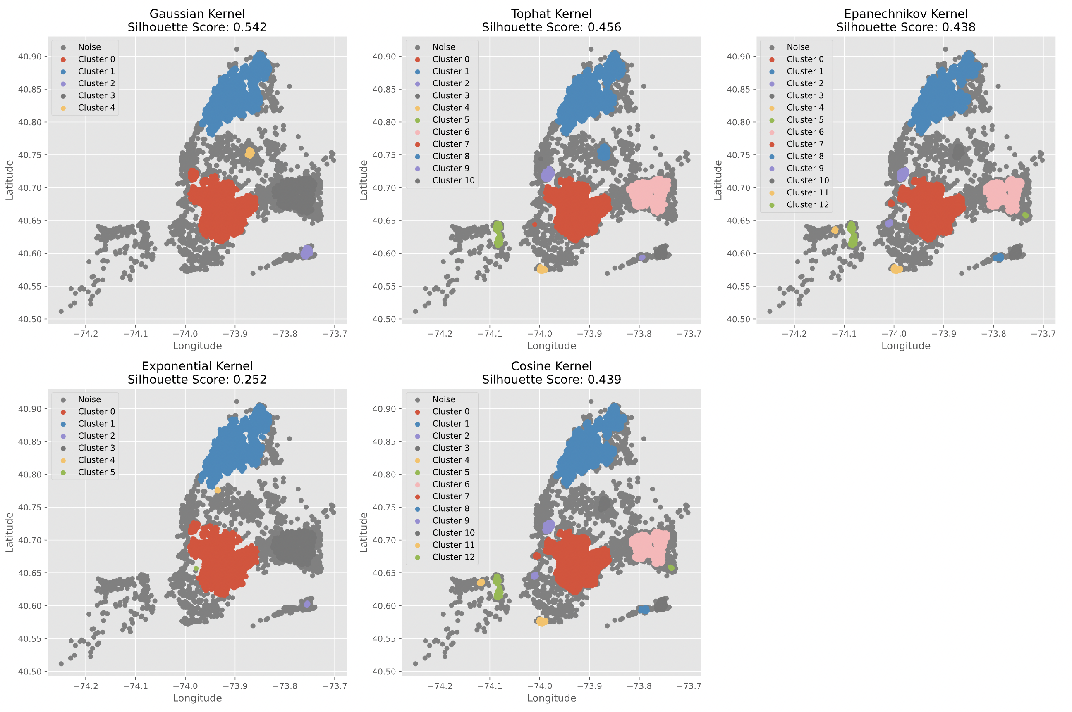
PRACTICAL EXAMPLE
KERNEL DENSITY BASED CLUSTERING
Silhouette Score:
Gaussian Kernel: 0.542 Tophat Kernel: 0.456 Epanechnikov: 0.438
Exponential Kernel: 0.252 Cosine Kernel: 0.439

Slide 17
CONCLUSION
Better Accuracy: Captures complex patterns and improves cluster precision.
Flexibility: Effectively handles irregular and overlapping clusters.
Density Adaptive: Adjusts to varying data densities for better separation.
Future Scope: Integrates with deep learning for large-scale, real-time applications.

Slide 18
THANK YOU !!

